Slide 1
Strategy Development for Targeting Users Likely to Create Goals and Invest on EduFund
Presenter: Anuj Pramod Satavase

Slide 2
Enhancing User Engagement and Participation
Objective:
Introduce the purpose of the presentation, which is to outline strategies for enhancing user engagement and encouraging goal creation and investment on the EduFund platform.
Highlight the significance of user engagement and participation for the success of EduFund as an educational planning and investment platform.
Provide an overview of the presentation agenda and topics to be covered, including key findings from data analysis, model predictions, and formulated strategies.
Explain the strategy development process aimed at targeting users more likely to create goals and invest on the EduFund platform.
Emphasize the ultimate goal of maximizing user engagement and satisfaction to foster a culture of financial planning and education investment among EduFund users.

Slide 3
Context
User engagement and participation play a pivotal role in shaping the success of EduFund as an educational planning and investment platform. As EduFund aims to empower individuals to plan and invest effectively in their education goals, fostering active engagement among users is essential for several reasons:
Maximizing Financial Literacy
Encouraging Goal Setting
Promoting Investment Behavior
Building a Supportive Community

Slide 4
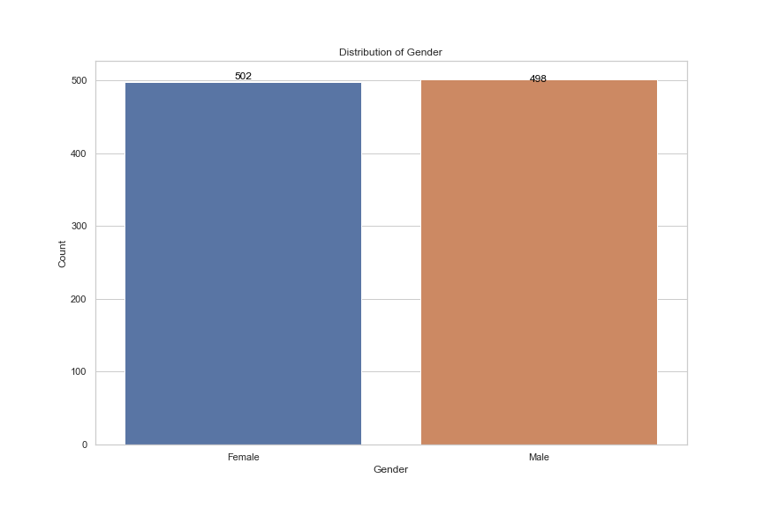
Key Findings
Distribution of Gender
Balanced representation of genders.
Approximately equal counts of male and female individuals.
Ensures fairness in gender-related analyses.
Gender balance impacts the inclusivity and validity of our insights.

Slide 5
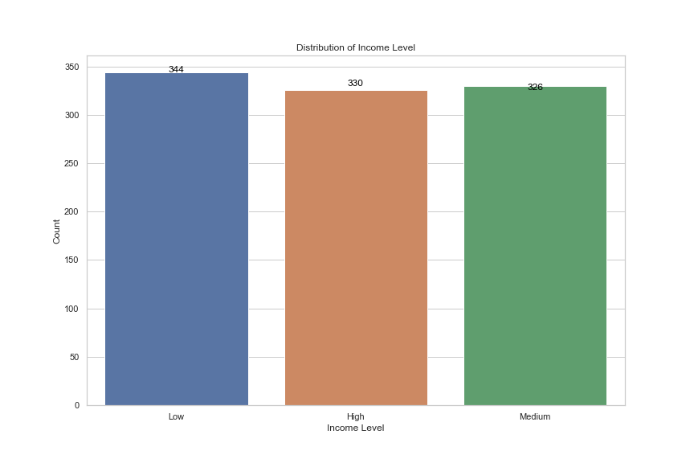
Key findings
Distribution of Income Level
Majority of individuals fall into the "Low" income category.
Followed by the "High" income category and then the "Medium" income category.
Understanding income distribution helps tailor financial products and services.
Influences decision-making regarding investment strategies and target demographics.

Slide 6
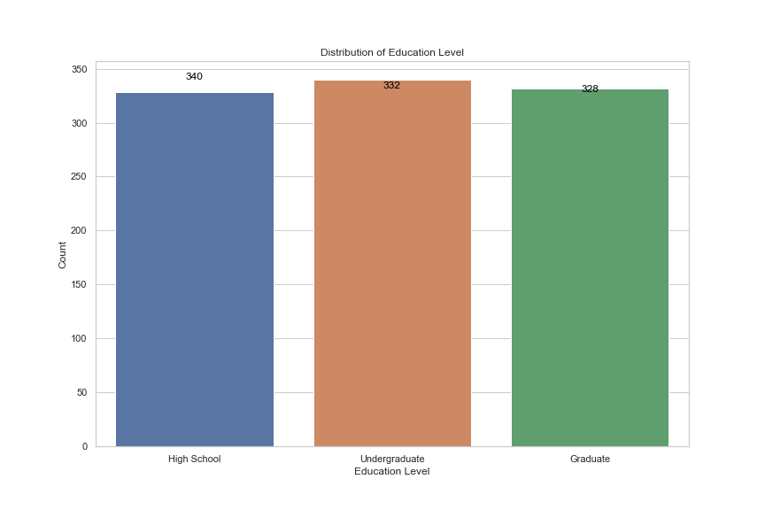
Key findings
Distribution of Education Level
Highest count in the "High School" education category.
Followed by "Undergraduate" and then "Graduate."
Education level affects financial literacy and investment decisions.
Helps in designing educational resources and outreach programs.

Slide 7
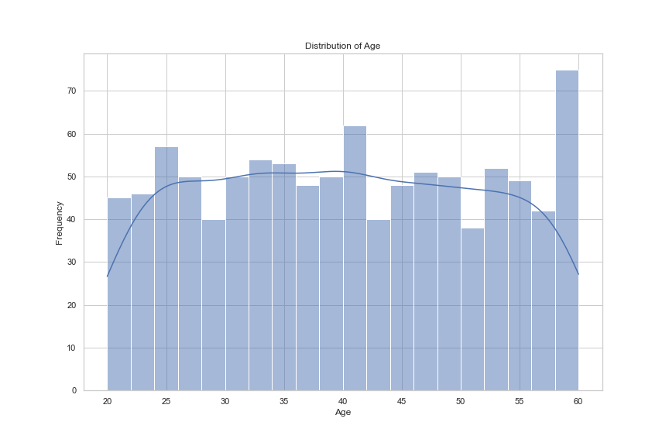
Key findings
Distribution of Age
Peak frequency observed in the 30-40 year age range.
Significant representation of individuals in the 20-60 year age range.
Understanding age demographics aids in targeting specific age groups for financial products and services.
Age distribution guides marketing strategies and retirement planning services.

Slide 8
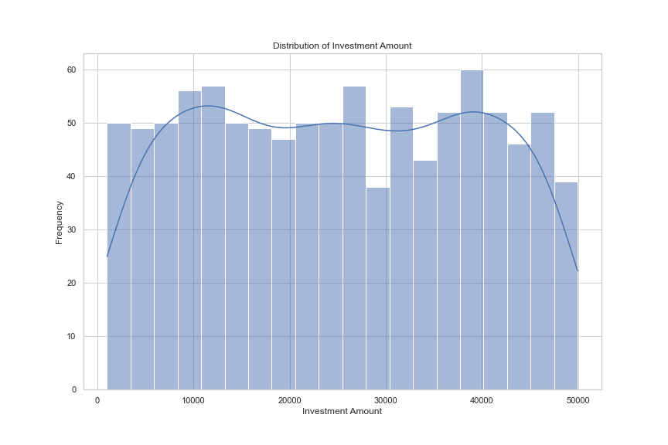
Key findings
Distribution of Investment Amount
Most investments concentrated in the lower range.
Decreasing frequency as investment amount increases.
Secondary concentration observed around 20,000 to 25,000 range.
Helps in understanding investment preferences and risk tolerance levels.
Guides product development and investment package offerings.

Slide 9
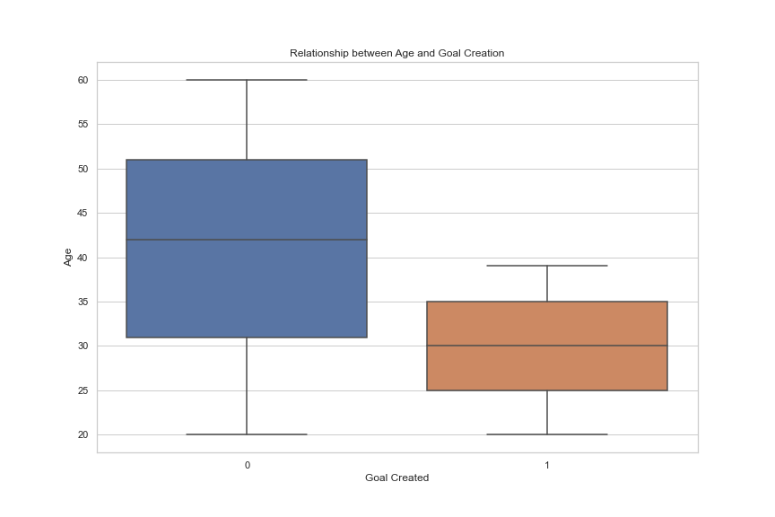
Key findings
Relationship between Age and Goal Creation
Median age of goal creators is lower compared to non-goal creators.
Younger users are more likely to create goals.
Age influences goal-setting behavior and financial planning.
Impacts platform design for goal creation and user engagement strategies.

Slide 10
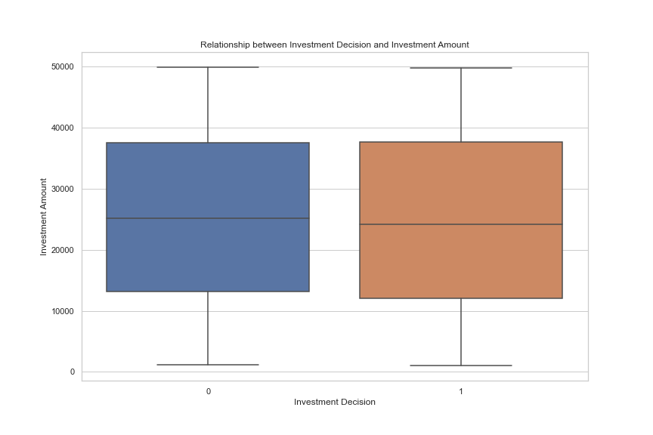
Key findings
Relationship between Investment Decision and Investment Amount
Similar median investment amounts for both decision categories.
Consistent distribution of investment amounts across decision categories.
Understanding the relationship aids in portfolio diversification strategies.
Influences decision-making on investment product offerings and marketing campaigns.

Slide 11
Strategy Development
Personalized Engagement:
Utilize demographic insights for tailored marketing efforts.
Implement personalized recommendations to encourage goal creation and investment.
Educational Content Creation:
Develop resources on financial planning for education.
Offer tutorials and guides on investment options.
Gamification and Incentives:
Introduce gamification elements to incentivize goal creation and investment.
Offer rewards or discounts for achieving goals or consistent investment.
Expert Guidance and Support:
Provide access to financial experts for personalized assistance.
Host webinars or live sessions for user queries.

Slide 12
Strategy Development
Seamless User Experience:
Optimize interface for intuitive goal creation and investment.
Streamline account setup and investment processes.
Community Building:
Foster community through forums and discussion groups.
Encourage peer-to-peer support and collaboration.
Data-Driven Iteration:
Regularly analyze user data to refine targeting strategies.
Optimize platform features based on insights.
Continuous Education and Communication:
Keep users informed about education planning and investment opportunities.
Provide resources on financial literacy topics.

Slide 13
Conclusion
We conclude that a comprehensive and targeted engagement strategy, informed by insightful data analysis, can effectively enhance user engagement and satisfaction on the EduFund platform.
By leveraging demographic insights, personalized recommendations, educational content, gamification, expert support, seamless user experience, community building, data-driven iteration, and continuous communication, EduFund can foster a culture of financial planning and education investment among its users.
This holistic approach ensures that users receive tailored support, guidance, and resources to make informed decisions about their education goals and investments, ultimately leading to a more engaging and satisfying user experience.

